Slide 1
Human embryo genome editing and pre-clinical studies: research ethics considerations
Dr Andy Greenfield
Medical Research Council, Mammalian Genetics Unit,
Harwell Institute, UK
a.greenfield@har.mrc.ac.uk

Slide 2
Some talking points:
The value of human embryo research – engagement
Feasibility of reproductive uses of genome editing: safety
and efficacy tests
3. Ethical concerns – ‘traditional’ and ‘strategic’

Slide 3
Some talking points:
The value of human embryo research – engagement
Feasibility of reproductive uses of genome editing: safety
and efficacy tests
3. Ethical concerns – ‘traditional’ and ‘strategic’

Slide 4
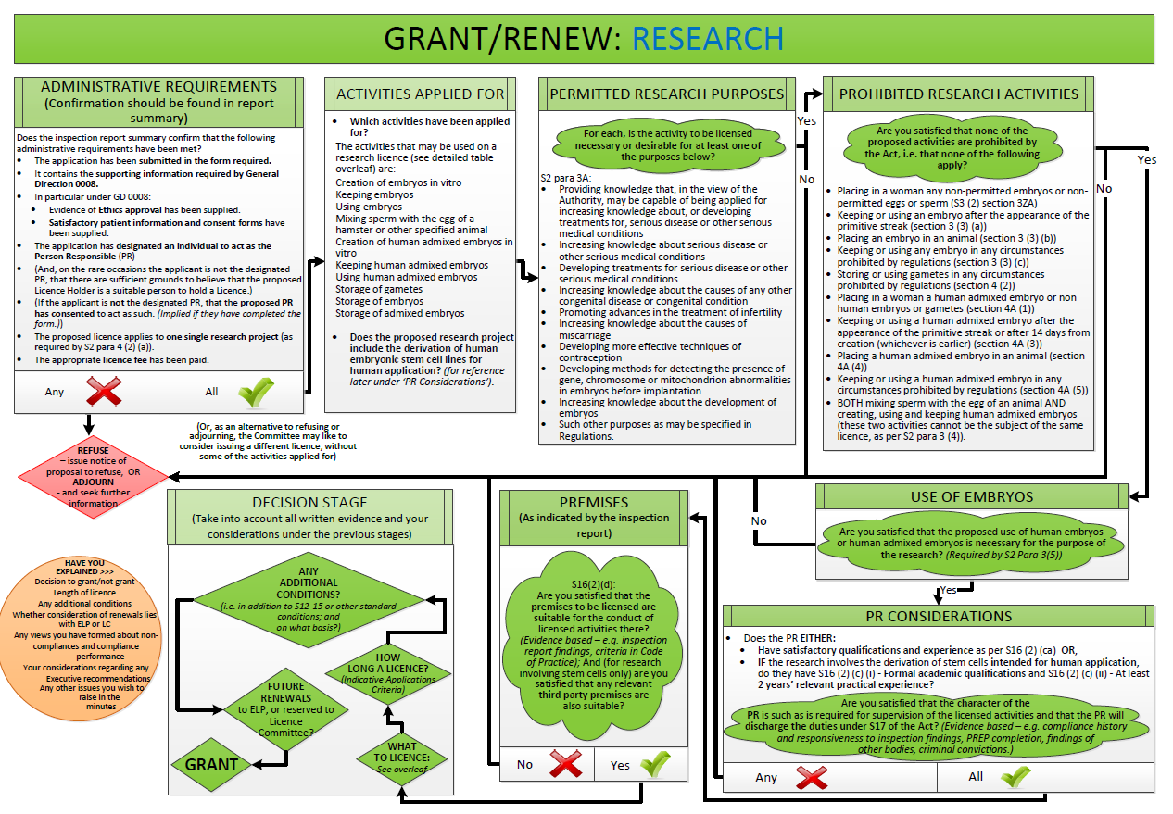

Slide 7
Some talking points:
The value of human embryo research – engagement
Feasibility of reproductive uses of genome editing: safety
and efficacy tests
3. Ethical concerns – ‘traditional’ and ‘strategic’

Slide 9
Some talking points:
The value of human embryo research – engagement
Feasibility of reproductive uses of genome editing: safety
and efficacy tests
3. Ethical concerns – ‘traditional’ and ‘strategic’

Slide 12
